Slide 1
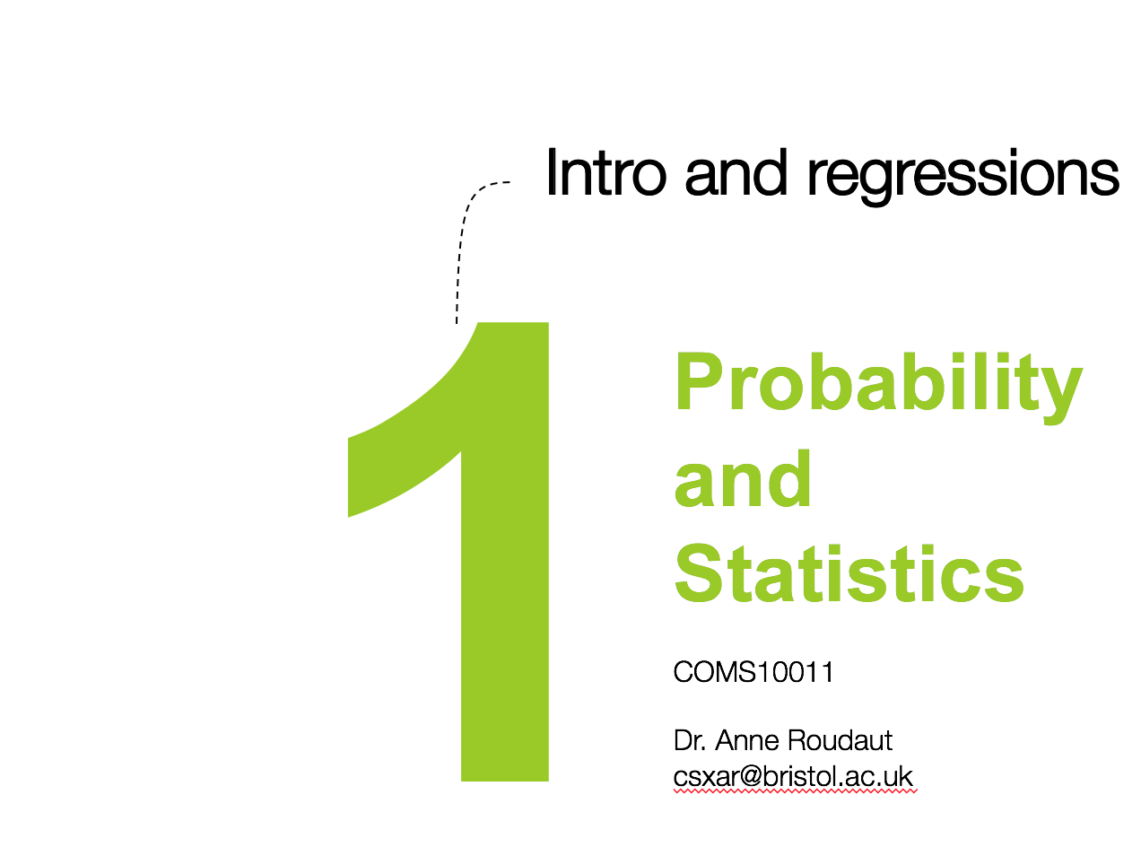


Slide 2
Intro and regressions
11
Probability
and
Statistics
COMS10011
Dr. Anne Roudaut
csxar@bristol.ac.uk

Slide 3
who am i?

Slide 4
Human Computer Interaction (HCI)::
a multidisciplinary field of study focusing on the design of computer technology and, in particular, the interaction between humans (the users) and computers

Slide 5
I
H
exp.
psych.
design
C
evaluate
design
prototype
comp science

Slide 6
I
H
exp.
psych.
design
C
evaluate
design
prototype
comp science

Slide 7
experimental psychology::
the branch of psychology concerned with the scientific investigation of the responses of individuals to stimuli in controlled situations
e.g. bandwagon effect (one of our many cognitive biases) phenomenon whereby the rate of uptake of beliefs, ideas, fads and trends increases the more that they have already been adopted by others

Slide 8
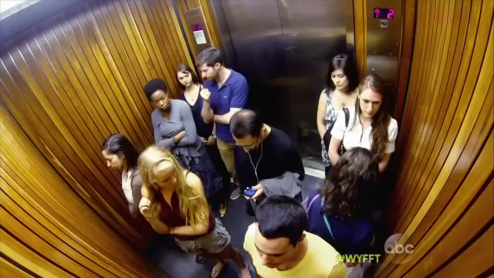

Slide 9


Slide 10
what is the link with statistic?
well, like in many fields related to computer science, statistics is the main tool to evaluate, demonstrate, predict or analyse data

Slide 11
let’s start with an example

Slide 12
imagine you are designing a graphical interface for a new application on a laptop
how big should the buttons/icons be?

Slide 13
Fitts’law ::
the time required to acquire a target of size w at distance d can be described as T = a + b log (1 + d/w)
T = a + b IndexDifficulty
(depends on input device)

Slide 14
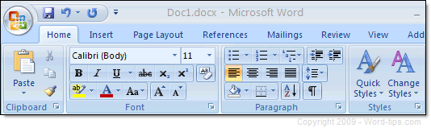
e.g. one reason why we have ribbons in Word now

Slide 15

smaller glasses = harder and further = harder

Slide 16
Fitts’law ::
the time required to acquire a target
T = a + b ID
but where does this equation come from?

Slide 17
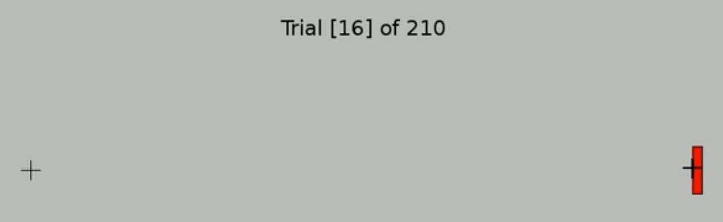
let’s run an experiment and ask one participant to click on targets of IDs

Slide 18
T time
(ms)
ID index of difficulty

Slide 19
T time
(ms)
y = a + b x
Fitts! T = a + b ID
ID index of difficulty
we just did a linear regression!

Slide 20
regression ::
a technique for determining the statistical relationship between two or more variables where a change in a dependent variable is associated with, and depends on, a change in one or more independent variables
arguably the most basic technique for machine learning

Slide 21
quick terminology of regressions

Slide 22
T time
(ms)
ˆ
y = a + b x
independent variable
ID index of difficulty

Slide 23
T time
(ms)
ˆ
y = a + b x
dependent variable
independent variable
ID index of difficulty

Slide 24
T time
(ms)
ˆ
y = a + b x
a is the y intercept
ID index of difficulty

Slide 25
T time
(ms)
b is the slope
ˆ
y = a + b x
a is the y intercept
ID index of difficulty

Slide 26
T time
(ms)
residual (deviation)
b is the slope
ˆ
y = a + b x
a is the y intercept
ID index of difficulty

Slide 27
goodness of fit

Slide 28
T time
(ms)
T = 2.3 + 1.1 ID
how can you be sure this line is a good fit to our data?
ID index of difficulty

Slide 29
T time
(ms)
T = 2.3 + 1.1 ID
how can you be sure this line is a good fit to our data? what about now?
ID index of difficulty
<1min brainstorming with your neighbor>

Slide 30
we can compute the goodness of fit with several methods
e.g. standard error of the estimate
or R squared

Slide 31
1
standard error of the estimate
T time
(ms)
Fitts! T = 2.3 + 1.1 ID
∑ ( )²
(sample size-2)
ID index of difficulty

Slide 32
1
standard error of the estimate
T time
(ms)
Fitts! T = 2.3 + 1.1 ID
ˆ
∑ (estimated y – actual y)²
(sample size-2)
ID index of difficulty

Slide 33
S gives a standard error in the metric of the data (the less the better)

Slide 34
2
R squared
T time
(ms)
mean
Fitts! T = 2.3 + 1.1 ID
∑ ( )²
ID index of difficulty
∑ ( )²

Slide 35
2
R squared
T time
(ms)
mean
Fitts! T = 2.3 + 1.1 ID
ˆ
∑ ( estimated y – mean y )²
ID index of difficulty
∑ ( actual y – mean y )²

Slide 36
R² gives a percentage and 100% means perfect fit (>70% is better)
we become sure at X % that the equation fits the data

Slide 37
T time
(ms)
T = 2.3 + 1.1 ID
R² = 0.97
how can you be sure this is a good fit but also a good representation of the human ability?
ID index of difficulty

Slide 38
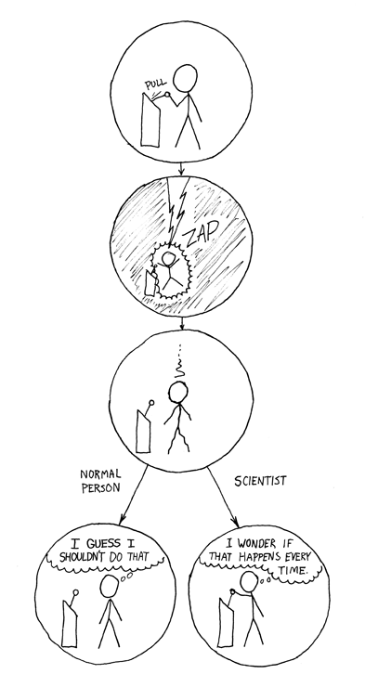
to gain additional confidence we repeat
we gain trust in a model if it fits the data with little error when
it is verified with a lot of data
it holds across very different people,
it is verified in independent studies…

Slide 39
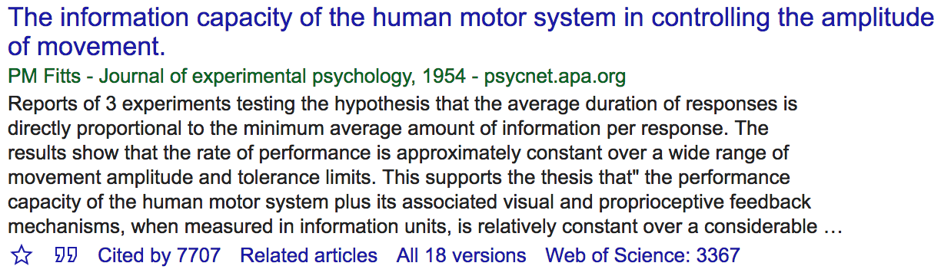
Fitts’s original paper is probably the most cited in HCI, studies done and redone many times
Notes:
28 + brainstorming

Slide 40
practically

Slide 41
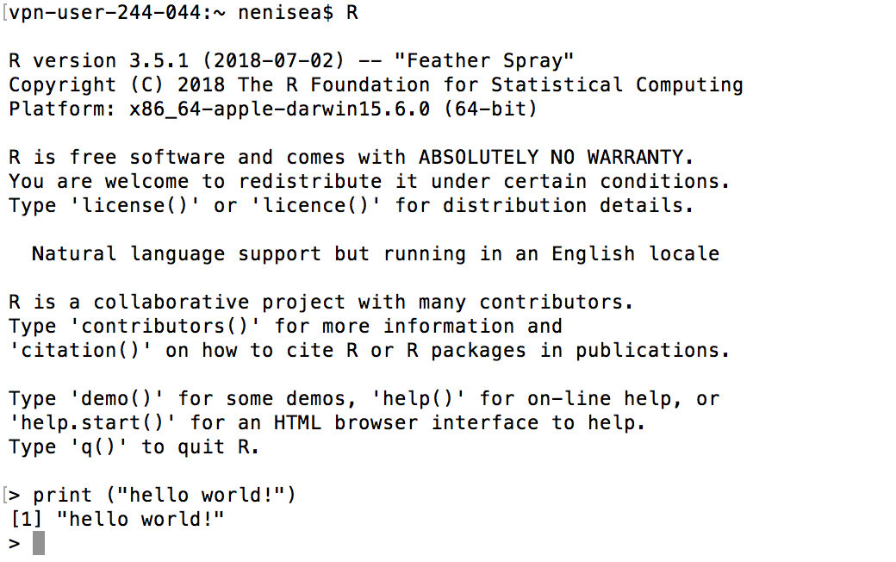
R
we will be using R and I will try to give you as much as possible of examples
Notes:
Open terminal
R
Print(“hello world!”)

Slide 42
R
in your terminal
head(cars) # cars is a table that already comes with R and contain 50 observations of speed and distance in two rows
scatter.smooth(x=cars$speed, y=cars$dist, main="Dist ~ Speed")
linearMod <- lm(dist ~ speed, data=cars) # build linear regression model
abline(linearMod, col="blue") # draw the regression line
summary(linearMod) # goodness of fit
Notes:
head(cars) # cars is a table that already comes with R and contain 50 observations of speed and distance in two rows
scatter.smooth(x=cars$speed, y=cars$dist, main="Dist ~ Speed") # scatterplot
linearMod <- lm(dist ~ speed, data=cars) # build linear regression model on full data
summary(linearMod) # summary(linearMod)$r.squared
abline(linearMod, col="blue")

Slide 43
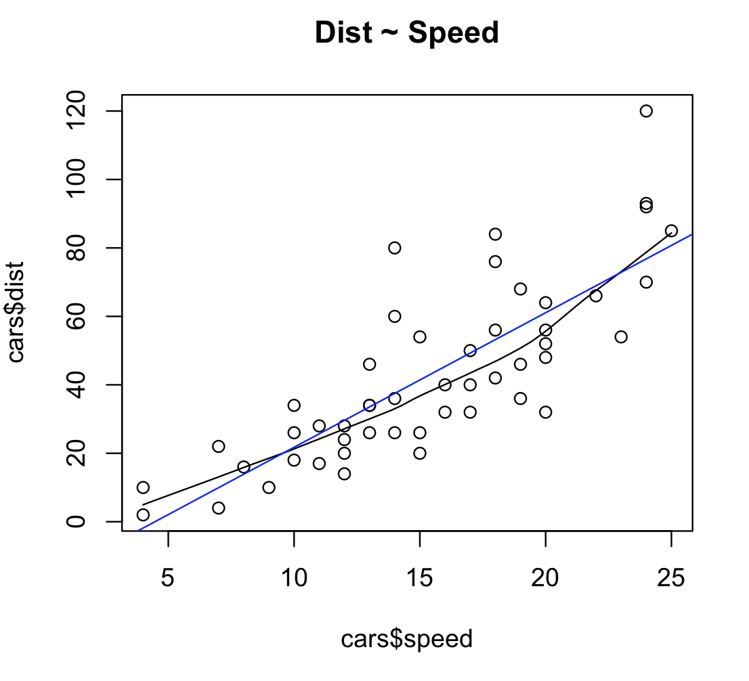
R

Slide 44
R
Call:
lm(formula = dist ~ speed, data = cars)
Residuals:
Min 1Q Median 3Q Max
-29.069 -9.525 -2.272 9.215 43.201
Coefficients:
Estimate Std. Error t value Pr(>|t|)
(Intercept) -17.5791 6.7584 -2.601 0.0123 *
speed 3.9324 0.4155 9.464 1.49e-12 ***
---
Signif. codes: 0 ‘***’ 0.001 ‘**’ 0.01 ‘*’ 0.05 ‘.’ 0.1 ‘ ’ 1
Residual standard error: 15.38 on 48 degrees of freedom
Multiple R-squared: 0.6511, Adjusted R-squared: 0.6438
F-statistic: 89.57 on 1 and 48 DF, p-value: 1.49e-12
dist = -17.6 + 2.9 * speed

Slide 45
R
Call:
lm(formula = dist ~ speed, data = cars)
Residuals:
Min 1Q Median 3Q Max
-29.069 -9.525 -2.272 9.215 43.201
Coefficients:
Estimate Std. Error t value Pr(>|t|)
(Intercept) -17.5791 6.7584 -2.601 0.0123 *
speed 3.9324 0.4155 9.464 1.49e-12 ***
---
Signif. codes: 0 ‘***’ 0.001 ‘**’ 0.01 ‘*’ 0.05 ‘.’ 0.1 ‘ ’ 1
Residual standard error: 15.38 on 48 degrees of freedom
Multiple R-squared: 0.6511, Adjusted R-squared: 0.6438
F-statistic: 89.57 on 1 and 48 DF, p-value: 1.49e-12
also note this
<0.01
<0
(will explain next week)

Slide 46
other applications

Slide 47
predictive analysis
predicting the number of items a consumer will purchase e.g. check your amazon/ebay history!
predicting the number of shopper who will pass in front of a particular public billboard and use the data for advertisement bidding
predicting the number of claim in a given time period (used by insurance companies)

Slide 48
optimize processes
understand the impact of each machine on a production line on the quality of a product
understand the relationship between wait times of callers and number of complaints in a call centre
a retail store manager wanting to extend shopping hours to increase sales, but regression indicates that increase in revenue not sufficient to support rise in operating expenses

Slide 49
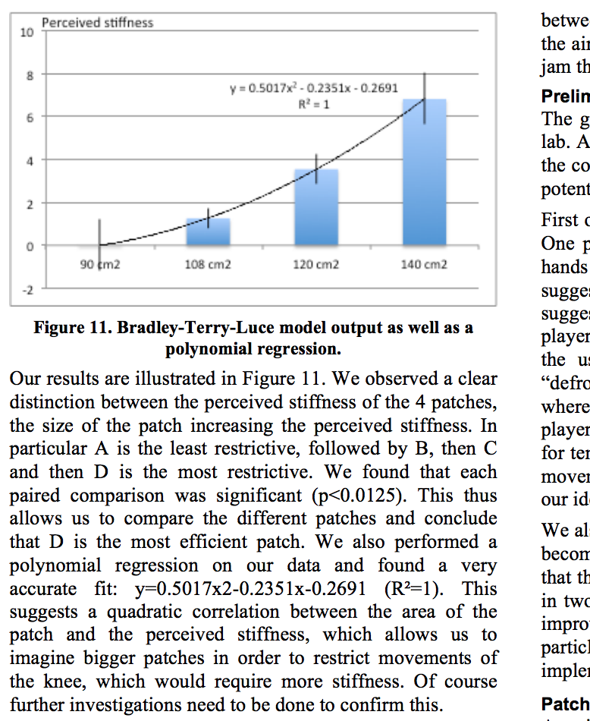
here a curve = polynomial fitting

Slide 50
R
polynomial regression model
Mod2 <- lm(dist~poly(speed,2,raw=TRUE), data=cars)
Mod3 <- lm(dist~poly(speed,3,raw=TRUE), data=cars)
Mod4 <- lm(dist~poly(speed,4,raw=TRUE), data=cars)
Notes:
11

Slide 51
the next half of this unit

Slide 52
the text book I am using and a suggestion of YouTube video channel

Slide 53
continuous independent variable
What type of data?
discrete independent variable
continuous dependent variable
discrete dependent variable
continuous dependent variable
discrete dependent variable
regressions
Logistic
regressions
normally distributed
skewed
2 grp
>2 grp
2 grp
>2 grp
2 grp
>2 grp
Non paired
paired
Non paired
paired
Non paired
paired
Non paired
paired
Counts >= 5 in >= 75% cells
Counts >= 5 in < 75% cells
T-test
ANOVA
Mann-Whitney Utest
Wilcoxon signed rank test
Kruskall-Wallis test
Chi-square test
Fisher’s exact test
Chi-square test
Paired-t-test
Friiedman test
McNemar’s test

Slide 54
continuous independent variable
What type of data?
discrete independent variable
continuous dependent variable
discrete dependent variable
continuous dependent variable
discrete dependent variable
regressions
Logistic
regressions
normally distributed
skewed
2 grp
>2 grp
by the end of this unit you will know what statistics tests to perform depending on your data and how
2 grp
>2 grp
2 grp
>2 grp
Non paired
paired
Non paired
paired
Non paired
paired
Non paired
paired
Counts >= 5 in >= 75% cells
Counts >= 5 in < 75% cells
T-test
ANOVA
Mann-Whitney Utest
Wilcoxon signed rank test
Kruskall-Wallis test
Chi-square test
Fisher’s exact test
Chi-square test
Paired-t-test
Friiedman test
McNemar’s test

Slide 55
continuous independent variable
What type of data?
discrete independent variable
continuous dependent variable
discrete dependent variable
continuous dependent variable
discrete dependent variable
regressions
Logistic
regressions
normally distributed
skewed
2 grp
>2 grp
2 grp
>2 grp
2 grp
>2 grp
Non paired
paired
Non paired
paired
Non paired
paired
Non paired
paired
Counts >= 5 in >= 75% cells
Counts >= 5 in < 75% cells
T-test
ANOVA
Mann-Whitney Utest
Wilcoxon signed rank test
Kruskall-Wallis test
Chi-square test
Fisher’s exact test
Chi-square test
Paired-t-test
Friiedman test
McNemar’s test

Slide 56
continuous independent variable
What type of data?
discrete independent variable
continuous dependent variable
discrete dependent variable
won't look at that
continuous dependent variable
discrete dependent variable
regressions
logistic
regressions
normally distributed
skewed
2 grp
>2 grp
2 grp
>2 grp
2 grp
>2 grp
Non paired
paired
Non paired
paired
Non paired
paired
Non paired
paired
Counts >= 5 in >= 75% cells
Counts >= 5 in < 75% cells
T-test
ANOVA
Mann-Whitney Utest
Wilcoxon signed rank test
Kruskall-Wallis test
Chi-square test
Fisher’s exact test
Chi-square test
Paired-t-test
Friiedman test
McNemar’s test

Slide 57
continuous independent variable
What type of data?
discrete independent variable
continuous dependent variable
discrete dependent variable
wont look at that
continuous dependent variable
discrete dependent variable
regressions
Logistic
regressions
normally distributed
skewed
2 grp
>2 grp
2 grp
>2 grp
2 grp
>2 grp
Non paired
paired
Non paired
paired
Non paired
paired
Non paired
paired
Counts >= 5 in >= 75% cells
Counts >= 5 in < 75% cells
T-test
ANOVA
Mann-Whitney Utest
Wilcoxon signed rank test
Kruskall-Wallis test
Chi-square test
Fisher’s exact test
Chi-square test
Paired-t-test
Friiedman test
McNemar’s test

Slide 58
R
R plots
https://www.harding.edu/fmccown/r/
Notes:
head(cars) # cars is a table that already comes with R and contain 50 observations of speed and distance in two rows
scatter.smooth(x=cars$speed, y=cars$dist, main="Dist ~ Speed") # scatterplot
linearMod <- lm(dist ~ speed, data=cars) # build linear regression model on full data
summary(linearMod) # summary(linearMod)$r.squared
abline(linearMod, col="blue")

Slide 59
good videos
https://www.youtube.com/watch?v=WWqE7YHR4Jc
https://www.youtube.com/playlist?list=PLF596A4043DBEAE9C

Slide 60
end

